Slide 1


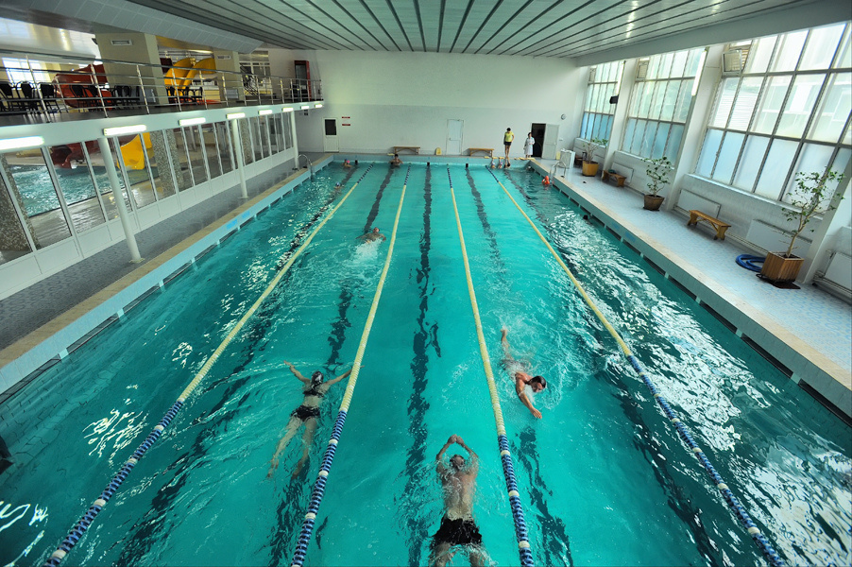
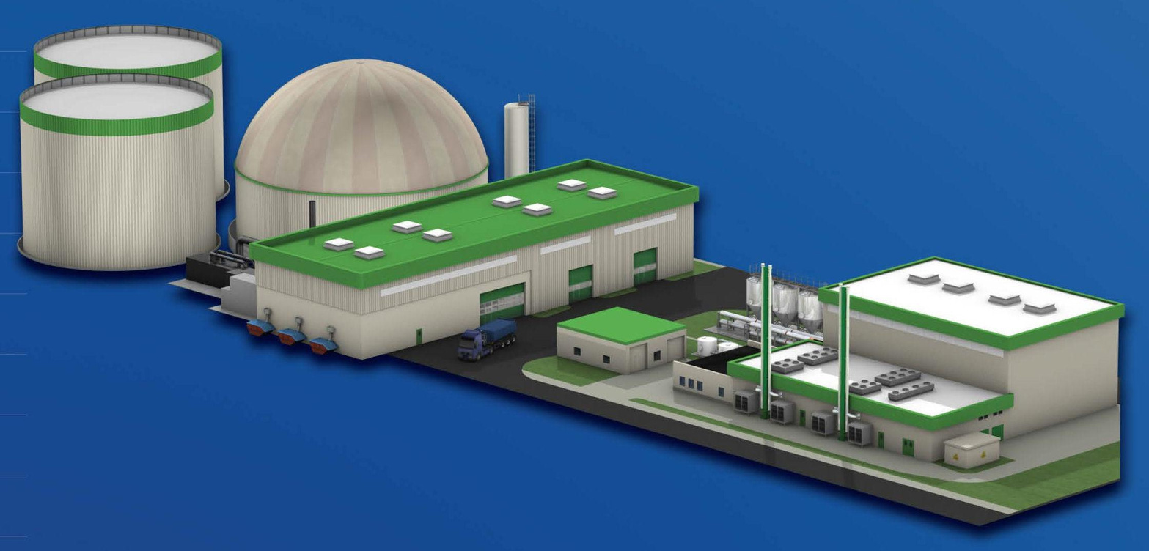
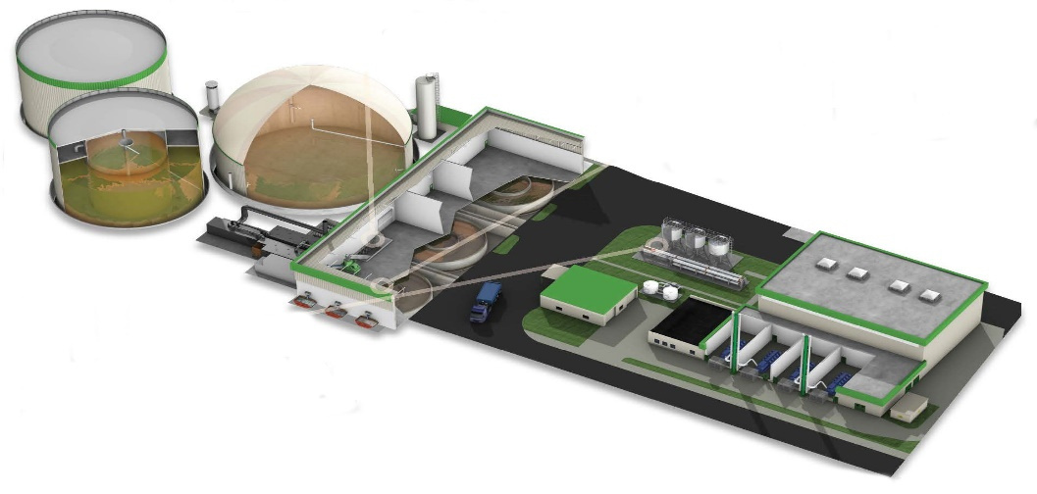


Project for the construction of a waste processing plant

Slide 2
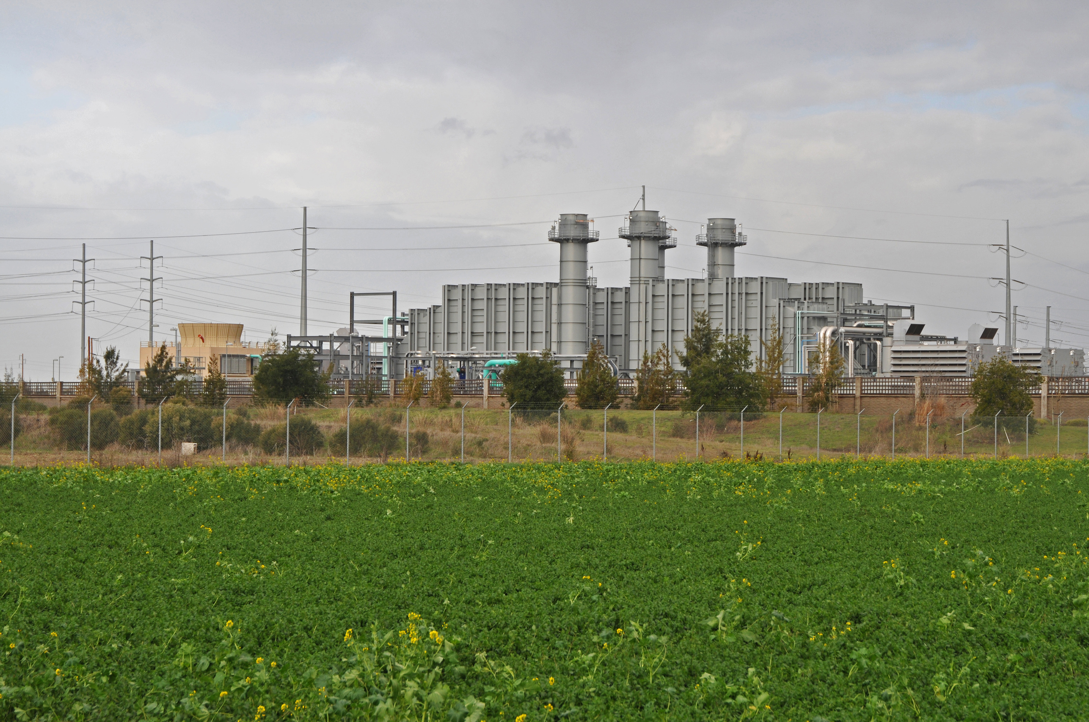














Project for the construction of a waste processing plant
The project includes the following work:
preparation of project documentation
obtaining approvals and permits
territory preparation
construction of the sorting line
main facilities and biogas plant
connection to heating and energy networks
The total cost of the project is
≈ 25 000 000 EUR

Slide 3











Project Objectives:
construction of a modern household waste deep processing plant (up to 95%)
providing for the needs of the territorial communities of the Cherkasy district (up to 165 000 tons of waste per year)
compliance with EU environmental standards
creation of new jobs
production of heat and electrical energy
Construction of the plant will allow:
process almost all household waste from the territorial communities of the Cherkasy district, with a population of about 600 000 people
landfill only 5% of the total waste, significantly reducing the burden on the solid waste landfill
estimated number of new workplaces created: 50-100
produce approximately 24 000 mW/hours of electricity per year
generate about 8 million Nm3 of biogas
produce around 8,000 tons of fuel through polymer processing

